Slide 1

Google Cloud Platform

Slide 2
Google Cloud Platform
Google Cloud Platform (GCP)
Before we begin with what is Google Cloud Platform, why use GCP, what it offers, just think through the challenges that we face using traditional infrastructure.
Challenges like,
What do we during a disaster?
How are we catering to ever growing ecosystem/demand
Maintenance and house-keeping for a datacentre
Keeping a fool-proof system
Handling security of the system
What is Cloud?
How is Cloud Computing changing the world?

Slide 3
Introduction
Cloud Platform
A Cloud is a comprehensive platform providing services that support application development and hosting. The services offered by a cloud platform may be categorized into fundamental services and higher level services. The higher level services are built on top of the fundamental layer.
The fundamental services offered by Amazon and Google Cloud platforms are:
Compute
Storage
Networking
Databases

Slide 4
Cloud Computing
Cloud computing is defined as the services offered through remote servers on the internet. These services might include database storage, applications, compute power and other IT resources over the pay-as-you-go pricing approach. The remote server allows users to save, modify, or process data on the internet or cloud-based platform instead of storing it on a local server or their devices.
Cloud computing is evolving due to fast performance, better manageability, and less maintenance. It helps organizations to minimize the number of resources and overall infrastructure costs. Additionally, it helps IT teams better focus on the important applications, services, and processes and achieve the company's goals.
Typically, the cloud-computing providers offer their services according to the following three standard models:
Platform as a Service (PaaS)
Software as a Service (SaaS)
Infrastructure as a Service (IaaS)

Slide 5
Cloud Computing
There are certain services and models working behind the scene making the cloud computing feasible and accessible to end users. Following are the working models for cloud computing:
Deployment Models
Service Models
Deployment Models
Deployment models define the type of access to the cloud, i.e., how the cloud is located? Cloud can have any of the four types of access: Public, Private, Hybrid, and Community.

Slide 6
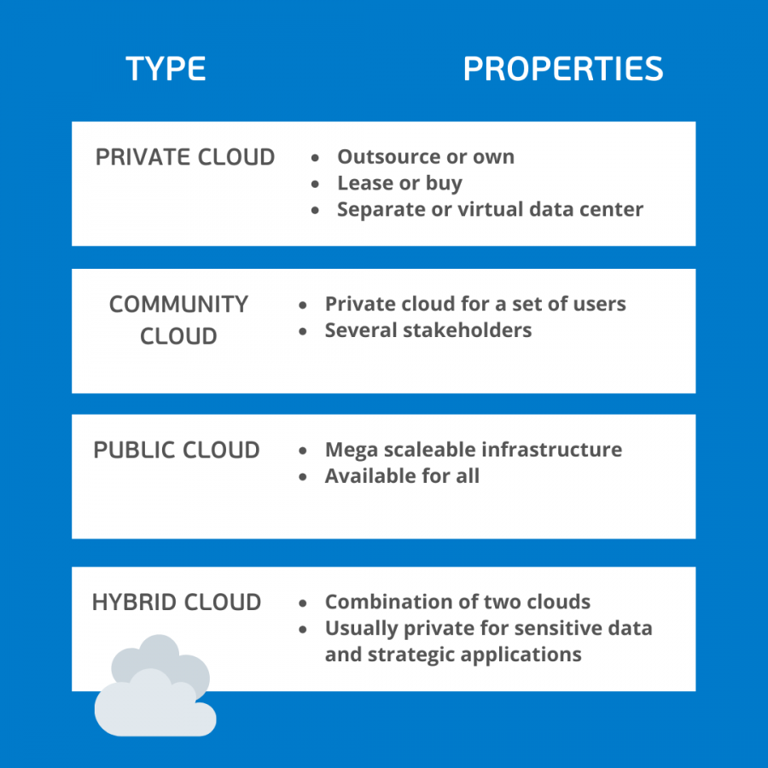
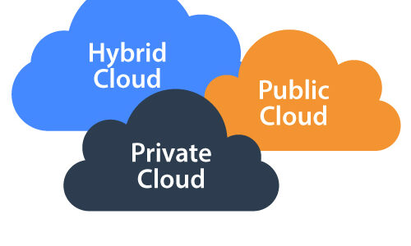
Cloud Computing

Slide 7
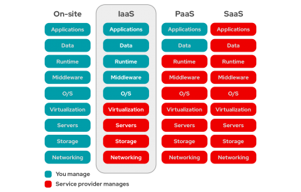
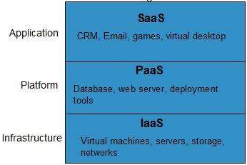
Service Models

Slide 8
Cloud Computing
Now, “Cloud is a collection of servers and computers connected by a network which is owned by a third party vendor somewhere on the globe“
Cloud made sure following things were taken care of:
Utmost care of Data Security by implementing stringent policies
Ensures use of Dynamically Scalable Servers
Provide you with Fast Computation and Remote Access to devices
Flexible Pricing ensures high Cost Optimization
Thus Cloud emerged as a savior and with it we saw different Cloud Service Providers like Google Cloud Platform, Amazon Web Services, Microsoft Azure etc. make their mark in the Cloud domain.

Slide 9
GCP Account Setup
Let's start with the steps of creating a free tier account on Google Cloud Platform:
Step 1: First, we are required to navigate to the following link: https://cloud.google.com/gcp/
Step 2: On the next screen, we need to click on 'Get started for free’
Step 3: Next, we are required to login to the Google Account
On the next screen, we have to enter some necessary details such as name and address details. Also, we have to enter payment details like the method of payments and credit card details. After filling all the details, we need to click on the button 'START MY FREE TRIAL’
On the next screen, we must click on the 'GO TO CONSOLE' button

Slide 10
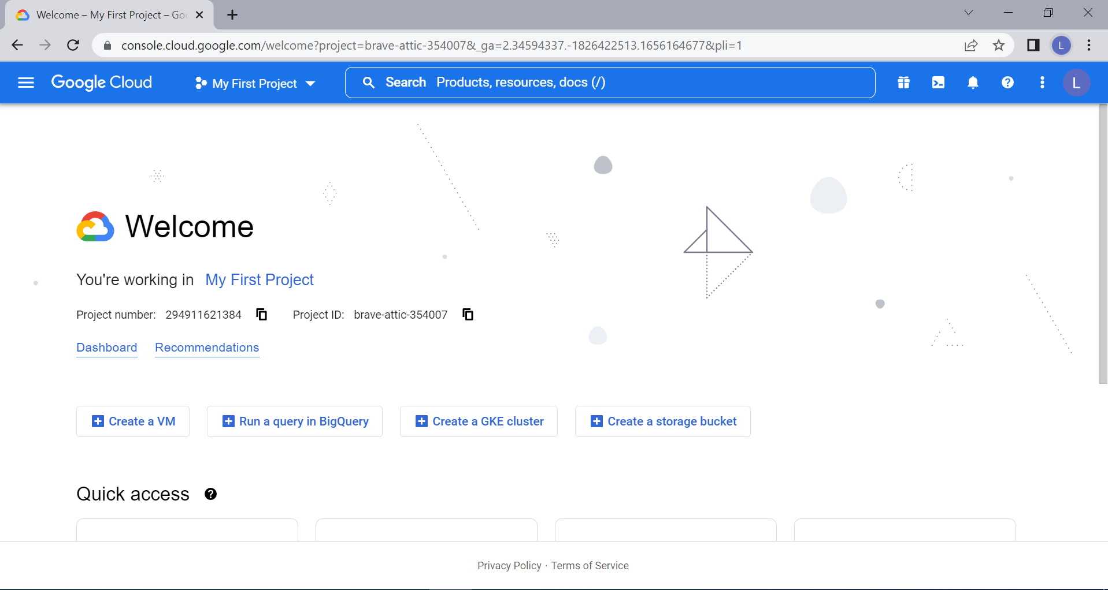
Google Cloud Platform

Slide 11
Types of Google Account
Google Cloud Platform (GCP)
Google Cloud Platform provides infrastructure as a service, platform as a service, and serverless computing environments as a individual account.
Google Workspace
Google Workspace plans provide a custom email for your business and include collaboration tools like Gmail, Calendar, Meet, Chat, Drive, Docs, Sheets, Slides, Forms, Sites and more
Google Workspace business solutions seamlessly integrate everything that you and your team need to get anything done, all-in-one place, including professional @yourcompany email.

Slide 12
Regions and Zones
Region – Physical Datacenter
Regions are collections of zones. Zones have high-bandwidth, low-latency network connections to other zones in the same region. In order to deploy fault-tolerant applications that have high availability,
Zone – within Region
A zone is a deployment area for Google Cloud resources within a region. The fully-qualified name for a zone is made up of <region>-<zone>. For example, the fully qualified name for zone a in region us-central1 is us-central1-a.
Depending on how widely you want to distribute your resources, create instances across multiple zones in multiple regions for redundancy.
Zones should be considered a single failure domain within a region. To deploy fault-tolerant applications with high availability and help protect against unexpected failures, deploy your applications across multiple zones in a region.
Global – Global IIT
The whole infrastructure of your application/product.

Slide 13
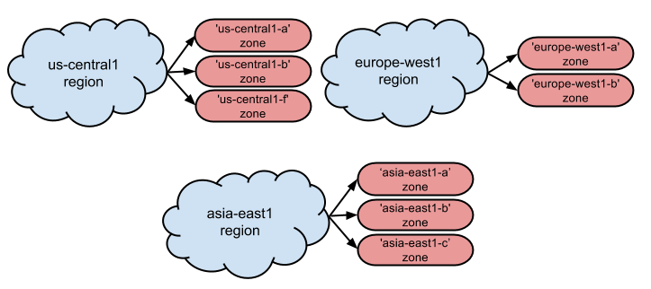
Regions and Zones
The following is a list of available regions and zones.
Region | Available zones | Supported processor types
US | us-central1-a us-central1-b | Sandy Bridge
 | us-central1-f | Ivy Bridge
Europe | europe-west1-a europe-west1-b | Sandy Bridge
Asia | asia-east1-a asia-east1-b asia-east1-c | Ivy Bridge

Slide 14
Resource Hierarchy
Google Cloud Resources
Everything that is being used on Google Cloud Platform is said to be resources. All the Google cloud resources are organized hierarchically like parent-child relationships. In the hierarchy organization node is the root node, projects are the children of the organization, and the other resources are descendants of the projects.
You can set Cloud Identity and Access Management (Cloud IAM) policies at different levels of the resource hierarchy and the resources inherit the policies applied at the parent level. Each resource has exactly one parent.
Google Cloud Resources Lifecycle
The fundamental components that make up all Google Cloud services are said to be resources. Examples: Compute Engine Virtual Machines (VMs),Cloud Storage buckets, App Engine instances, Pub/Sub topics.

Slide 15
Resource Hierarchy
The purpose of the Google Cloud resource hierarchy is two-fold
Provide a hierarchy of ownership, which binds the lifecycle of a resource to its immediate parent in the hierarchy.
Provide attach points and inheritance for access control and organization policies.

Slide 16
Resource Hierarchy
Organization resource
It is the root node in the resource hierarchy. It represents an organization, for example, a company.
Projects resource
For example, to separate projects for production and development environments. They are required to create resources.
Folder resource
They provide an extra level of project isolation. For ex, creating a folder for each department in a company.
Virtual machines, database instances, load balancers, and so on.
Resources

Slide 17
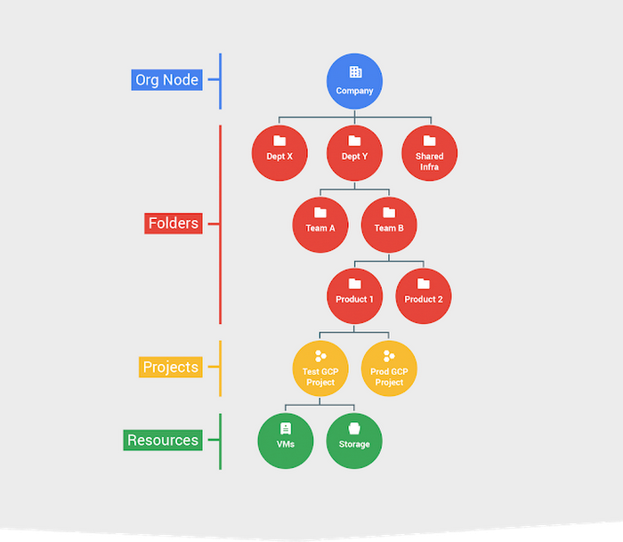
Resource Hierarchy
Four Pillars Of Google Cloud Resources
Organization
Folders
Projects
Resources

Slide 18
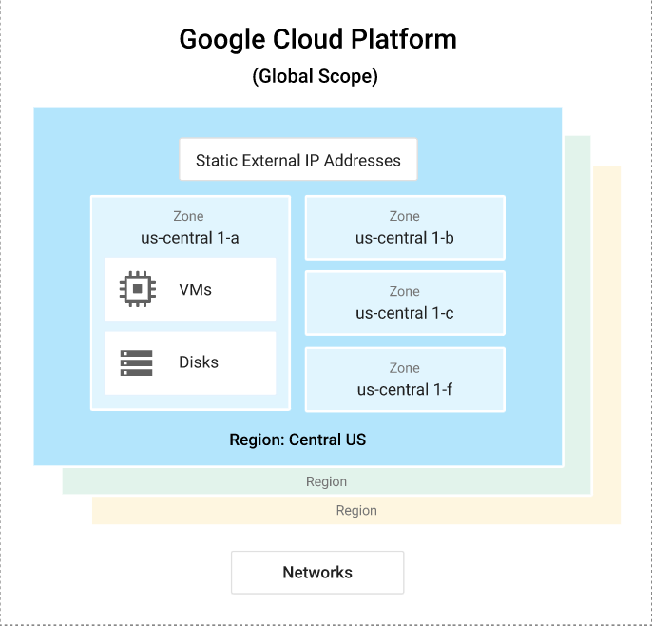
Projects
The following diagram shows the relationship between global scope, regions and zones, and some of their resources

Slide 19
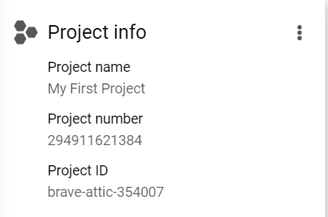
Projects
Any Google Cloud resources that you allocate and use must belong to a project. You can think of a project as the organizing entity for what you're building.
A project is made up of the settings, permissions, and other metadata that describe your applications. Resources within a single project can work together easily, for example by communicating through an internal network, subject to the regions-and-zones rules.
A project can't access another project's resources unless you use Shared VPC or VPC Network Peering.
A project serves as a namespace. This means every resource within each project must have a unique name, but you can usually reuse resource names if they are in separate projects. Some resource names must be globally unique.

Slide 20
Cloud SDK – gcloud CLI
The Google Cloud CLI is a set of tools to create and manage Google Cloud resources. You can use these tools to perform many common platform tasks from the command line or through scripts and other automation.
You can use the gcloud CLI to create and manage the following:
Compute Engine virtual machine instances and other resources
Cloud SQL instances
Google Kubernetes Engine clusters
Cloud DNS managed zones and record sets
Cloud Deployment Manager deployments
You can also use the gcloud CLI to deploy App Engine applications, manage authentication, customize local configuration, and perform other tasks.

Slide 21
Cloud SDK – gcloud CLI
Install the Google Cloud CLI
Follow https://cloud.google.com/sdk/docs/install-sdk#installing_the_latest_version
Commands:
https://github.com/miracle2cloud/gcp/blob/main/Cloud%20SDK%20CLI%20Commands.docx
When you start using the gcloud CLI, you'll work with a single configuration named default and you can set properties by running gcloud init or gcloud config set. This single default configuration is suitable for most use cases.
To work with multiple projects or authorization accounts, you can set up multiple configurations with gcloud config configurations create and switch among the configurations. Within a configuration, you can customize properties

Slide 22
Cloud SDK – gcloud CLI
You can run gcloud commands in the following ways:
You can install the Google Cloud CLI. The gcloud CLI lets you open a terminal window on your own computer and run commands to manage Google Cloud resources.
You can use Cloud Shell, which is a browser-based shell. Because it runs in a browser window, you don't need to install anything on your own computer. You can open the Cloud Shell from the Google Cloud console.
For more commands check - https://cloud.google.com/sdk/docs/cheatsheet

Slide 23
Cloud Shell
Cloud Shell provides the following:
A temporary Compute Engine virtual machine instance.
A built-in code editor.
5 GB of persistent disk storage.
Pre-installed gcloud CLI and other tools.
Language support for Java, Go, Python, Node.js, PHP, Ruby and .NET.
Web preview functionality.
Built-in authorization for access to Google Cloud console projects and resources.

Slide 24
Virtual Private Cloud (VPC)
Virtual Private Cloud (VPC) provides networking functionality to Compute Engine virtual machine (VM) instances, Google Kubernetes Engine (GKE) clusters, and the App Engine flexible environment.
VPC provides networking for your cloud-based resources and services that is global, scalable, and flexible.
VPC networks
You can think of a VPC network the same way you'd think of a physical network, except that it is virtualized within Google Cloud. A VPC network is a global resource that consists of a list of regional virtual subnetworks (subnets) in data centers, all connected by a global wide area network. VPC networks are logically isolated from each other in Google Cloud.

Slide 25
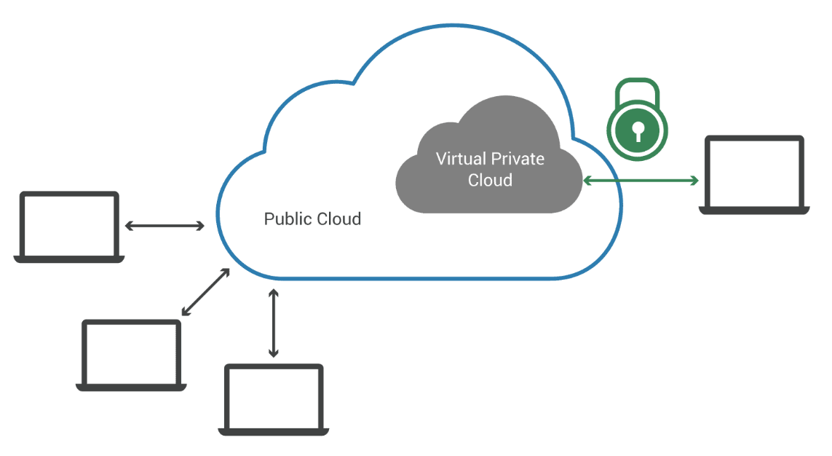
Virtual Private Cloud (VPC)

Slide 26
VPC network overview
A Virtual Private Cloud (VPC) network is a virtual version of a physical network, implemented inside of Google's production network.
A VPC network provides the following:
Provides connectivity for your Compute Engine virtual machine (VM) instances, including Google Kubernetes Engine (GKE) clusters, App Engine flexible environment instances, and other Google Cloud products built on Compute Engine VMs.
Offers native Internal TCP/UDP Load Balancing and proxy systems for Internal HTTP(S) Load Balancing.
Connects to on-premises networks using Cloud VPN tunnels and Cloud Interconnect attachments.
Distributes traffic from Google Cloud external load balancers to backends.
Projects can contain multiple VPC networks. Unless you create an organizational policy that prohibits it, new projects start with a default network (an auto mode VPC network) that has one subnetwork (subnet) in each region.

Slide 27
VPC Subnet
Each VPC network consists of one or more useful IP range partitions called subnets and each subnet is associated with a region. VPC networks do not have any IP address ranges associated with them, IP ranges are defined for the subnets. Subnets are regional resources. Each subnet defines a range of IP addresses.
Please Note: The terms subnet and subnetwork are synonymous. They are used interchangeably in the Google Cloud Console, gcloud commands, and API documentation. However, a subnet is not the same thing as a VPC network. They both represent different types of objects in Google Cloud.
When a subnet is created, its primary IP address range must be defined. Optionally secondary IP address ranges can also be added to a subnet, which is only used by alias IP ranges. Each primary or secondary IP range for subnets in the VPC network needs to be a unique valid CIDR block.

Slide 28
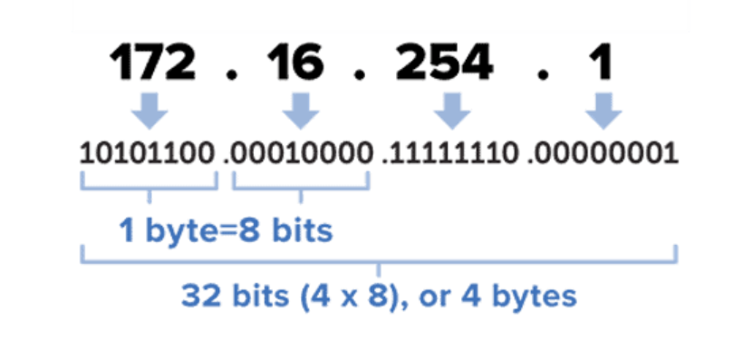
VPC Subnet
Subnet Calculator: https://www.subnet-calculator.com/subnet.php?net_class=A
CIDR: https://cidr.xyz/

Slide 29
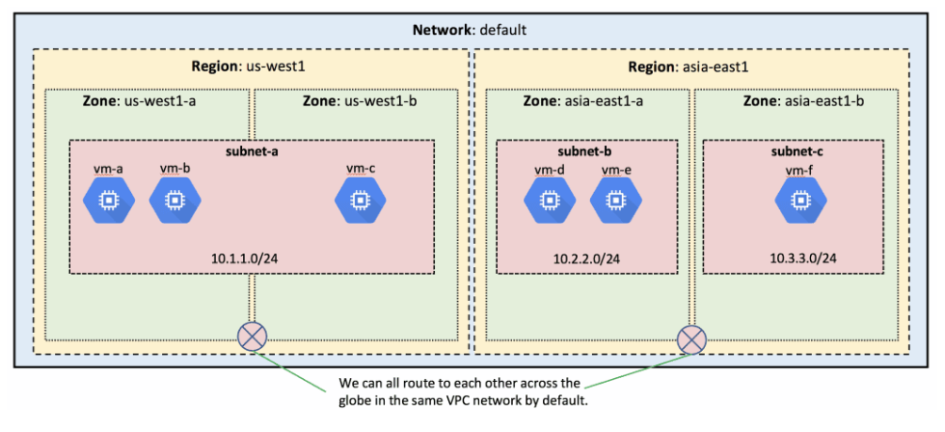
VPC Network
In this diagram, you can see the default VPC network spanning multiple regions and zones, and subnets within various parts of the network servicing VMs. All of these subnets can natively route to each other, and as long as the firewalls permit it, VMs can reach one another within this VPC.

Slide 30
Firewall
Firewall rules apply to both outgoing (egress) and incoming (ingress) traffic in the network. They manage traffic even if it is entirely within the network, including communication among VM instances.
Virtual Private Cloud firewall rules apply to a given project and network. They allow users to control which packets are allowed to travel to which destinations. Every VPC network has two implied firewall rules that block all incoming connections and allow all outgoing connections.
When you create a VPC firewall rule, a VPC network is specified along with a set of components that define what the rule does. The components enable you to target certain types of traffic, based on the traffic’s protocol, destination ports, sources, and destinations.

Slide 31
VPC Peering
VPC Network Peering enables you to peer VPC networks so that workloads in different VPC networks can communicate in private space. Traffic stays within Google’s network and doesn’t traverse the public internet.
VPC Network Peering is useful for:
SaaS (Software-as-a-Service) ecosystems in GCP. You can make services available privately across different VPC networks within and across organizations.
Organizations with several network administrative domains can peer with each other.

Slide 32
VPC Peering
VPC Network Peering provides following advantages over using external IP addresses or VPNs to connect networks, including:
Network Latency – connectivity uses only internal addresses and provides lower latency than connectivity that uses external addresses
Network Security – service owners do not need to have their services exposed to the public Internet and deal with its associated risks.
Network Cost – GCP charges egress bandwidth or outbound traffic for networks using external IPs to communicate even if the traffic is within the same zone. However, for peered networks as they use internal IPs to communicate and save on those egress costs.
Refer CLI commands for creating VPC peering here - https://github.com/miracle2cloud/gcp/blob/main/VPC%20Peering%20CLI

Slide 33
Shared VPC
Shared VPC allows an organization to connect resources from multiple projects to a common VPC network to communicate with each other securely and efficiently using internal IPs from that network.
Allows you to
implement a security best practice of least privilege for network administration, auditing, and access control.
apply and enforce consistent access control policies at the network level for multiple service projects in the organization while delegating administrative responsibilities
use service projects to separate budgeting or internal cost centers.
This document describes on how to set up shared VPC. https://github.com/miracle2cloud/gcp/blob/main/GCP-Shared-VPC.docx

Slide 34
IAM Roles
Identify and Access Management – IAM provides administrators the ability to manage cloud resources centrally by controlling who can take what action on specific resources.
Understand how IAM works and how rules apply esp. the hierarchy from Organization -> Folder -> Project -> Resources
Know more about IAM from here.
https://github.com/miracle2cloud/gcp/blob/main/GCP%20IAM%20Roles.docx

Slide 35
IAP Roles
Setup IAP
In the Cloud Console, go to the “Security > Identity-Aware Proxy” page.
Configure ‘OAuth consent screen’.
Set ‘User Type’ as Internal.
Enter Support email and Application name.
Click Save.
Setting up IAP access
On the Identity-Aware Proxy page, under HTTPS Resources.
Select the resource by checking the box to its left. On the right side panel, click Add Member.
In the Add members dialog, add the email addresses of groups or individuals to whom you want to grant the ‘IAP-secured Web App User’ role for the project.
Turning on IAP for app, with toggle slider.

Slide 36
Compute Engine - Disks
Compute Engine offers several types of storage options for your instances. Each of the following storage options has unique price and performance characteristics:
Zonal persistent disk: Efficient, reliable block storage.
Regional persistent disk: Regional block storage replicated in two zones.
Local SSD: High performance, transient, local block storage.
Cloud Storage buckets: Affordable object storage.
Filestore: High performance file storage for Google Cloud users.

Slide 37
Add a persistent disk to your VM
You can either create a blank persistent disk, or create a disk from a data source. You can use a persistent disk as a boot disk for a virtual machine (VM) instance, or as a data disk that you attach to a VM
Steps to increase size:
increase boot disk
sudo apt update -y
sudo apt install cloud-guest-utils -y
sudo lsblk
sudo growpart /dev/sda1
sudo lsblk
sudo resize2fs /dev/sda1
df –h (data will populate)
Refer: https://cloud.google.com/compute/docs/disks/add-persistent-disk

Slide 38
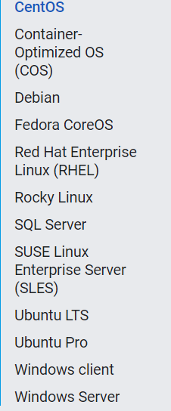
Compute Engine - Images
Use operating system images to create boot disks for your instances. You can use one of the following image types:
Public images are provided and maintained by Google, open source communities, and third-party vendors. By default, all Google Cloud projects have access to these images and can use them to create instances.
Custom images are available only to your Cloud project. You can create a custom image from boot disks and other images. Then, use the custom image to create an instance.
Available Public Images

Slide 39
Compute Engine - Images
You can create Custom Images from source disks, images, snapshots, or images stored in Cloud Storage and use these images to create virtual machine (VM) instances. Custom images are ideal for situations where you have created and modified a persistent boot disk or specific image to a certain state and need to save that state for creating VMs.
Create the image
You can create disk images from the following sources:
A persistent disk, even while that disk is attached to a VM
A snapshot of a persistent disk
Another image in your project
An image that is shared from another project
A compressed RAW image in Cloud Storage

Slide 40
Compute Engine - Snapshot
Snapshots incrementally back up data from your persistent disks. After you create a snapshot to capture the current state of the disk, you can use it to restore that data to a new disk.
You can create snapshots from disks even while they are attached to running virtual machine (VM) instances. The lifecycle of a snapshot created from a disk attached to a running VM instances is independent of the lifecycle of the VM instance.
Note that snapshots are different from custom images and machine images, which are useful for creating instance boot disks.
Create the image
You can create disk images from the following sources:
A persistent disk, even while that disk is attached to a VM
A snapshot of a persistent disk
Another image in your project
An image that is shared from another project
A compressed RAW image in Cloud Storage

Slide 41
Compute Engine - Snapshot
Go to the Create a Snapshot page in the Google Cloud console. Go to the Create a Snapshot page
Enter a snapshot Name.
Optionally, enter a Description of the snapshot.
Select the Source disk from the drop-down menu.
Determine your snapshot storage location. You can use the default storage location, or a custom storage location.
Under Location, select whether you want to store your snapshot in a Multi-regional location or a Regional location.
Select which specific region or multi-region that you want to use. To use the region or multi-region that is closest to your source disk, select Based on disk's location (default).
Click Create to create the snapshot.

Slide 42
Restore from a snapshot
A disk is either a boot disk that is used to start and run a VM's (virtual machine) operating system, or a non-boot disk that a VM uses only for data storage.
You can use snapshots to backup and restore disk data in the following ways:
After you take a snapshot of a boot or non-boot disk, create a new disk based on the snapshot.
After you take a snapshot of a boot disk, create a new VM based on the boot disk snapshot.
After you take a snapshot of a non-boot disk, create a new VM with a new non-boot disk based on the snapshot.

Slide 43
Compute Engine - Start up scripts
A startup script is a file that performs tasks during the startup process of a virtual machine (VM) instance.
Startup scripts can apply to all VMs in a project or to a single VM.
Startup scripts specified by VM-level metadata override startup scripts specified by project-level metadata, and startup scripts only run when a network is available
For Linux startup scripts, you can use bash or non-bash file. To use a non-bash file, designate the interpreter by adding a #! to the top of the file.

Slide 44
Compute Engine - Start up scripts
If you specify a startup script by using one of the procedures in this document, Compute Engine does the following:
Copies the startup script to the VM
Sets run permissions on the startup script
Runs the startup script as the root user when the VM boots
Passing a Linux startup script from a local file to a new VM
Create a VM and pass the contents of a local file to be used as the startup script by using the gcloud compute instances create command with the --metadata-from-file flag.
gcloud compute instances create nginx-webserver --image-project=debian-cloud --image-family=debian-10 --metadata-from-file=startup-script=startup.sh

Slide 45
Passing a Linux startup script
Passing a Linux startup script directly to a new VM
In the Google Cloud console, go to the Create an instance page.
Go to Create an instance
For Boot disk, select Change, and select a Linux operating system.
Expand the Networking, disks, security, management, sole tenancy section, and do the following:
Expand the Management section.
In the Automation section, add the following startup script:
Click Create.
#! /bin/bash
apt update apt -y install apache2
cat <<EOF > /var/www/html/index.html <html><body><p>Linux startup script added directly.</p></body></html>

Slide 46
Compute Engine - preemptible instance
What is a preemptible instance?
Preemptible VM instances are available at much lower price—a 60-91% discount - compared to the price of standard VMs. However, Compute Engine might stop (preempt) these instances if it needs to reclaim the compute capacity for allocation to other VMs.
Preemptible instances function like normal instances but have the following limitations:
Compute Engine might stop preemptible instances at any time due to system events. The probability that Compute Engine stops a preemptible instance for a system event is generally low, but might vary from day to day and from zone to zone depending on current conditions.
Compute Engine always stops preemptible instances after they run for 24 hours. Certain actions reset this 24-hour counter.
Preemptible instances are finite Compute Engine resources, so they might not always be available.
Preemptible instances can't live migrate to a regular VM instance, or be set to automatically restart when there is a maintenance event.

Slide 47
Compute Engine - Instance templates
An instance template is a resource that you can use to create virtual machine (VM) instances and managed instance groups (MIGs).
Instance templates define the machine type, boot disk image or container image, labels, startup script, and other instance properties. You can then use an instance template to create a MIG or to create individual VMs. Instance templates are a convenient way to save a VM instance's configuration so you can use it later to create VMs or groups of VMs.
An instance template is a global resource that is not bound to a zone or a region.

Slide 48
Compute Engine - Instance templates
When to use instance templates
Use instance templates any time you want to quickly create VM instances based off of a preexisting configuration. If you want to create a group of identical instances–a managed instance group (MIG)–you must have an instance template that the group can use.
You can either use a custom image or a public image for your instance templates:
Custom images. As MIGs are designed to add and remove instances frequently, it is useful to create a custom image and specify it in the instance template. You can prepare your image with the applications and settings that your VMs need, so you don't have to manually configure those items on individual VMs in the MIG.
Public images. You can create an instance template that uses a public image and a startup script to prepare the instance after it starts running.

Slide 49
Compute Engine - Instance groups
An instance group is a collection of virtual machine (VM) instances that you can manage as a single entity.
Compute Engine offers two kinds of VM instance groups, managed and unmanaged:
Managed instance groups (MIGs) let you operate apps on multiple identical VMs. You can make your workloads scalable and highly available by taking advantage of automated MIG services, including: autoscaling, autohealing, regional (multiple zone) deployment, and automatic updating.
Unmanaged instance groups let you load balance across a fleet of VMs that you manage yourself.

Slide 50
Managed instance groups (MIGs)
Use a managed instance group (MIG) for scenarios like these:
Stateless serving workloads, such as a website frontend
Stateless batch, high-performance, or high-throughput compute workloads, such as image processing from a queue
Stateful applications, such as databases, legacy applications, and long-running batch computations with checkpointing
Compute Engine maintains each of the MIG's managed instances based on the configuration that you specify in an instance template and optional stateful configuration.

Slide 51
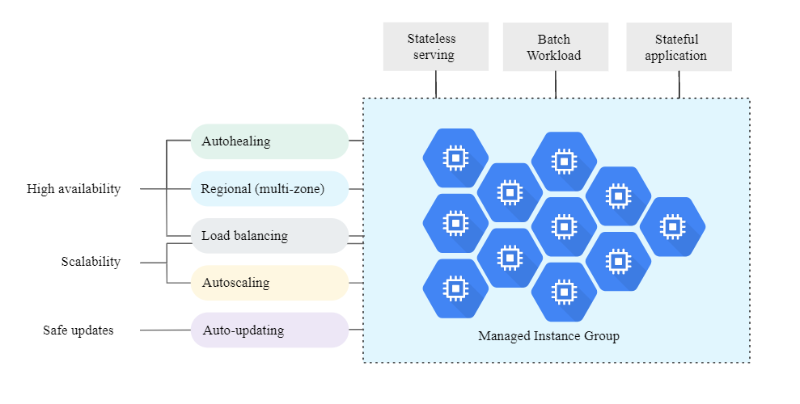
Managed instance groups (MIGs)
MIG capabilities and common workloads

Slide 52
Unmanaged Instance Groups
Unmanaged instance groups can contain heterogeneous instances that you can arbitrarily add and remove from the group. Unmanaged instance groups do not offer autoscaling, autohealing, rolling update support, multi-zone support, or the use of instance templates and are not a good fit for deploying highly available and scalable workloads. Use unmanaged instance groups if you need to apply load balancing to groups of heterogeneous instances, or if you need to manage the instances yourself.

Slide 53
Create a MIG with VMs in multiple zones in a region
In the console, go to the Instance groups page.
Go to the Instance groups page
Click Create instance group to create a new instance group.
Select one of the New managed instance group options:
Stateless (default)
Stateful
Assign a name and optionally a description to your instance group.
Choose an instance template for the instance group or create a new one.
In Number of instances or in Autoscaling, specify the number of instances for this group.
Under Location, select Multiple zones.
Choose a region and select the zones you want to use.
Under Target distribution shape, select Even.
If you want to disable proactive instance redistribution:
Ensure that Autoscaling mode is set to Off: do not autoscale.
Under Instance redistribution, deselect the Enable instance redistribution checkbox.
Continue with the rest of the MIG creation process.

Slide 54
Unmanaged Instance Groups
Unmanaged instance groups can contain heterogeneous instances that you can arbitrarily add and remove from the group. Unmanaged instance groups do not offer autoscaling, autohealing, rolling update support, multi-zone support, or the use of instance templates and are not a good fit for deploying highly available and scalable workloads. Use unmanaged instance groups if you need to apply load balancing to groups of heterogeneous instances, or if you need to manage the instances yourself.

